Slide 1
Thinking reactive

Slide 2
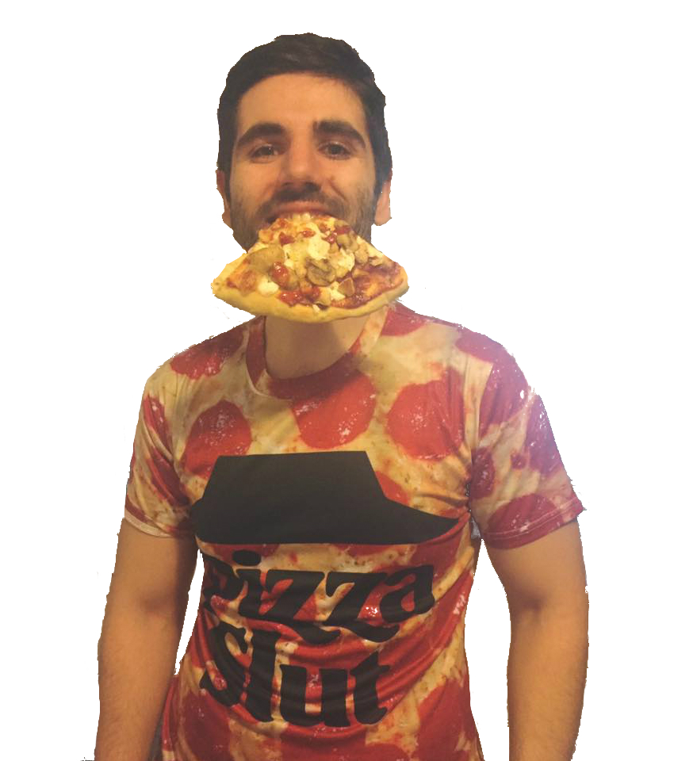
Who is speaking?
Software developer at Seavus
Member of JugMK
coffee - code - pizza - repeat

Slide 3
Agenda
Reactive applications
Reactive programming
Demo

Slide 4
Reactive applications

Slide 5
Why reactive?
End of the single-core, start of the multi-core era
Everything is distributed - distribution across networked machines - cloud
IoT around the corner with 26 billion devices
Our traditional approach doesn’t work here, we need tooling to work with this type of distribution

Slide 6
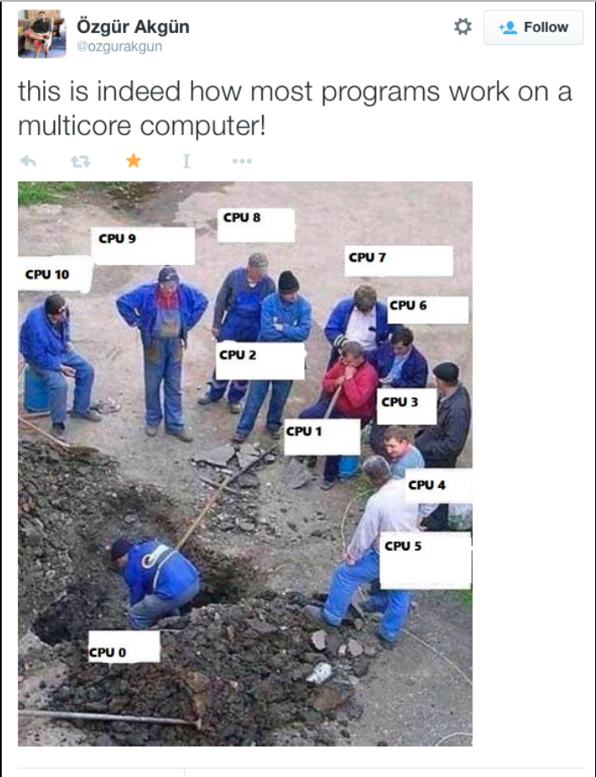

Slide 7
Clarification
• Reactive application
• Reactive programming
• Functional reactive programming
• Responsive web-application

Slide 8
Clarification
• Reactive application => architectural pattern
• Reactive programming => async data flows
• Functional reactive programming => async data flows + FP
• Responsive web-application => Twitter Bootstrap

Slide 9
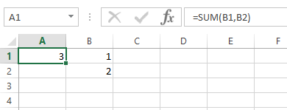
Spreadsheet as example of reactivity

Slide 10
Reactive: how? - In a pony world
@Elastic(minNodes = 5, maxNodes = 15)
@Resilient(gracefullyHandleNetworkPartitions = true)
public class PaymentController {
@Responsive(latency = 500, timeUnit = TimeUnit.MILLISECONDS) @MessageDriven(messageProvider = Provider.AKKA)
public PaymentConfirmation makePayment(CreditCard card) {...}
@Responsive(latency = 800, timeUnit = TimeUnit.MILLISECONDS)
public PaymentHistory getPastPayments() { ... } }

Slide 11
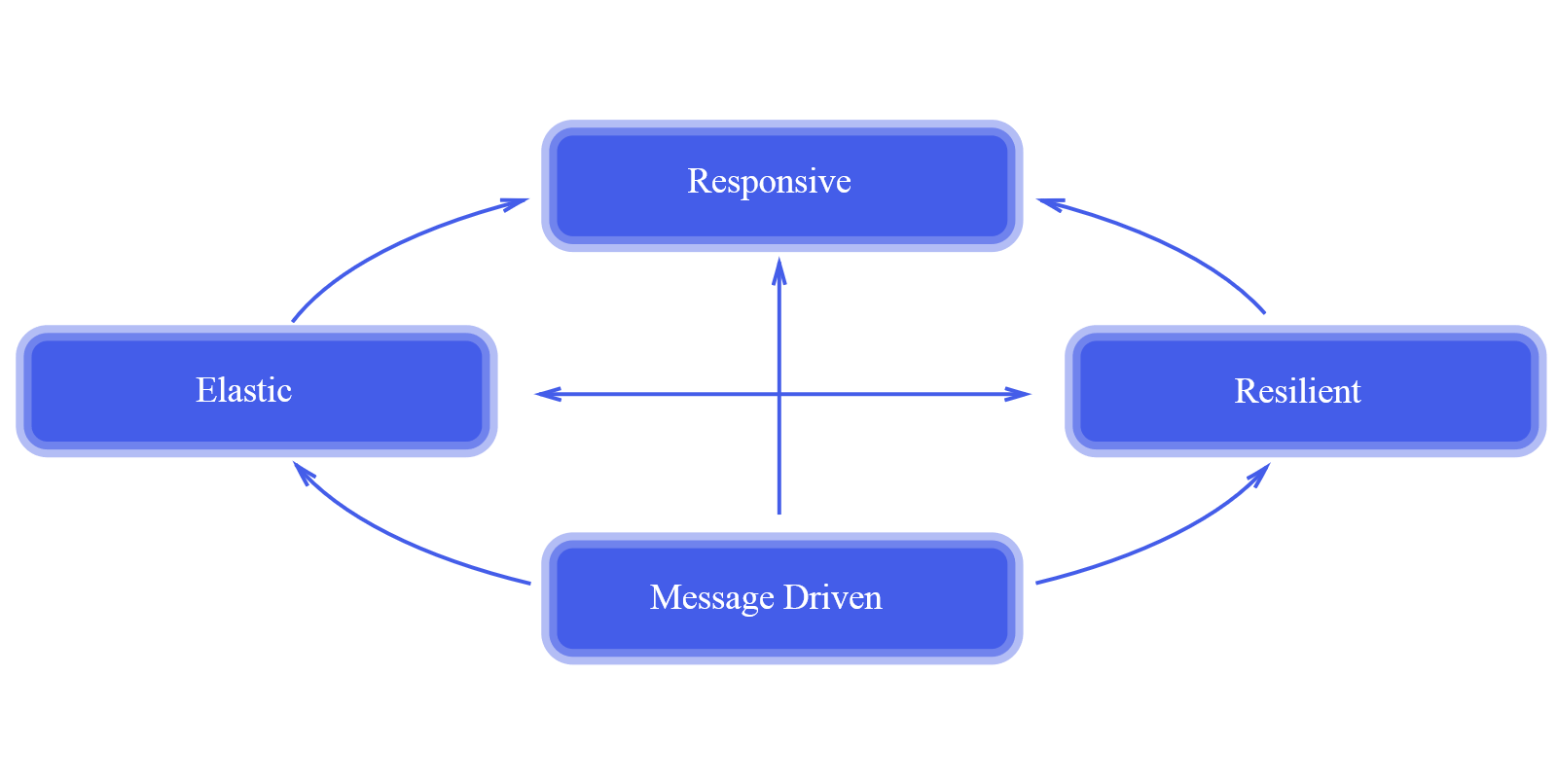
Principles for Reactive Application ( Reactive Manifesto )
Reactive applications are:
Responsive
Resilient
Elastic
Message Driven

Slide 12
Reactive applications - summary
• Distributed in nature
• Need to be resilient to failure and adapt to changes
• Asynchronous all the way down

Slide 13
Reactive programming

Slide 14
Why do we need yet another programming model?
Blocking is evil!
We need (reactive/parallelizable/compossible/readable) asynchronous code.
Async code is ugly!
What about Callbacks?
no composition, have you heard of Callback Hell?
What about Future<T>?
too easy to block with get()
complex beyond first level of composition

Slide 15
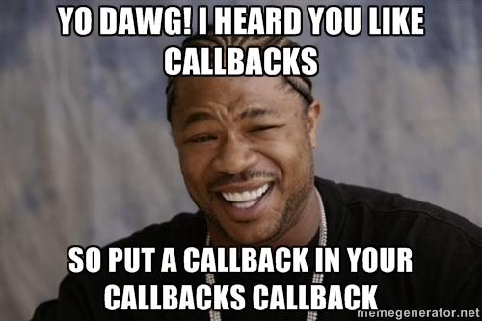
Callback hell
mApi.login(request, new Callback<LoginResponse>() {
@Override
public void success(LoginResponse s, Response response) {
mApi.getRoutes(request, new Callback<RoutesResponse>() {
@Override
public void success(RoutesResponses, Response response) {
...
}
@Override
public void failure(RetrofitError error) {}
}
}
@Override
public void failure(RetrofitError error) {}
});

Slide 16

Back to the Future<T>

Slide 17
Future<T>
Non-blocking, asynchronous computation
Holds a value which may become available at some point
Either completes with success or failure
Makes latency and asynchrony explicit

Slide 18
So what is reactive programming?
In computing, reactive programming is a programming paradigm oriented around data flows and the propagation of change. Wikipedia
Reactive programming is programming with asynchronous data streams.

Slide 19
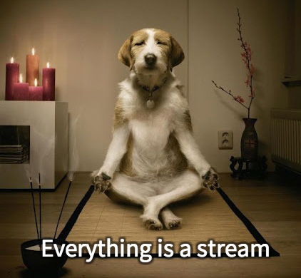
Reactive mantra

Slide 20
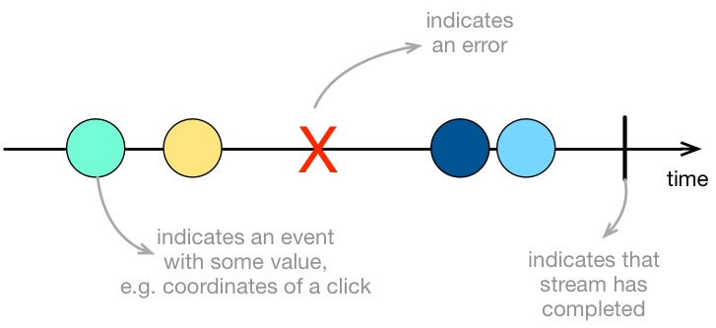
Reactive Stream

Slide 21
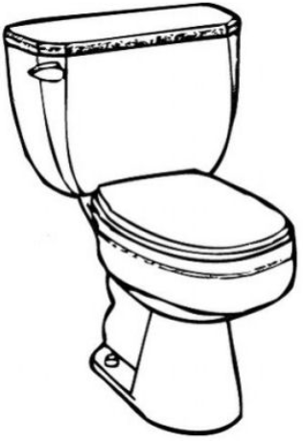
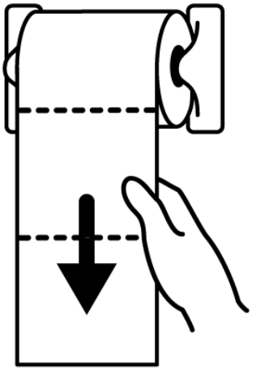
Push model VS Pull model
Producer in charge
Consumer in charge

Slide 22
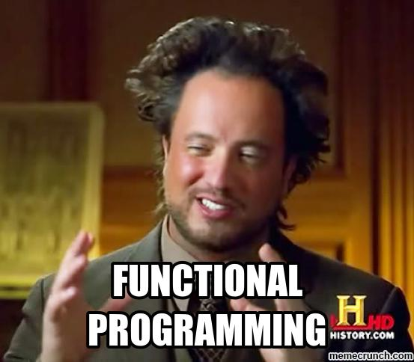
Functional reactive programming
Functional reactive programming is a programming paradigm for reactive programming using the building blocks of functional programming
FRP uses functional utilities like map, filter, and reduce to create and process data streams which propagate changes through the system

Slide 23
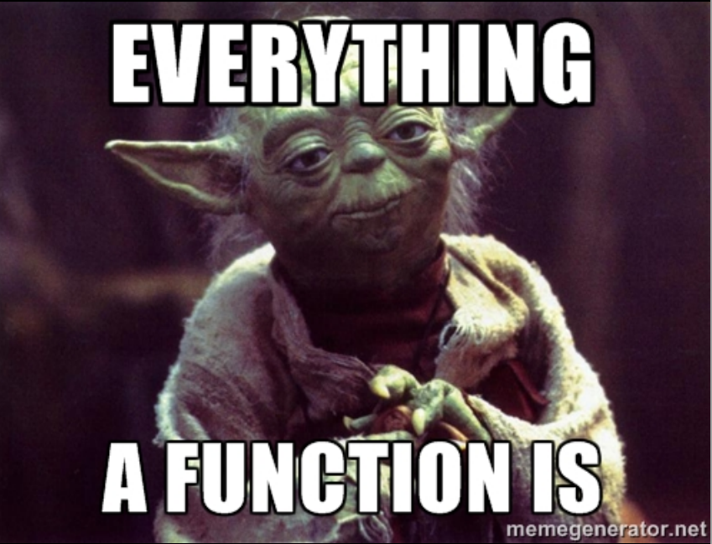
Functions
portable and re-usable behavior
data changes, behavior can be reused
functions as data transformation pipelines

Slide 24
Functions = data transformation pipelines
List<Address> addresses = users
.filter( user -> user.age > 18)
.map(user -> user.address)
.sortBy(user-> user.city)
.collect(toList())
Build increasingly complex behavior through a series of transformations driven
by composing functions

Slide 25
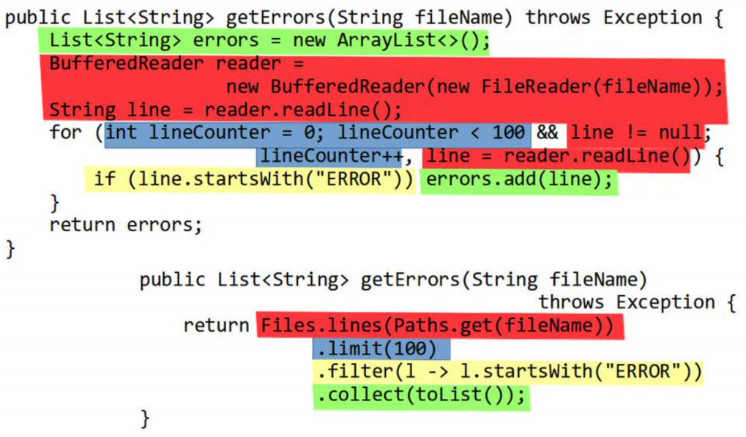
Imperative vs Functional

Slide 26
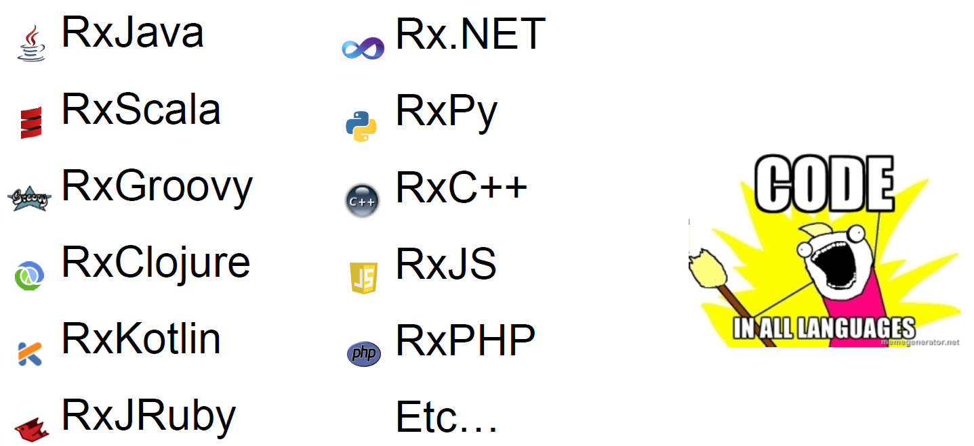
Reactive programming tools
Reactive extensions

Slide 27
Reactive programming tools
Bacon.js
Kefir.js
Sodium - Functional Reactive Programming in C#, C++, Java, Haskell and Scala
Scala.react
etc..

Slide 28
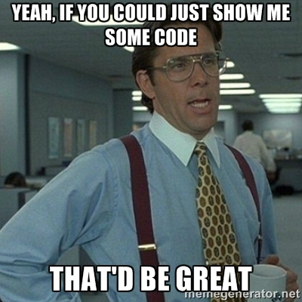
Demo time – Smart home
https://github.com/martinmax/SmartHome

Slide 29
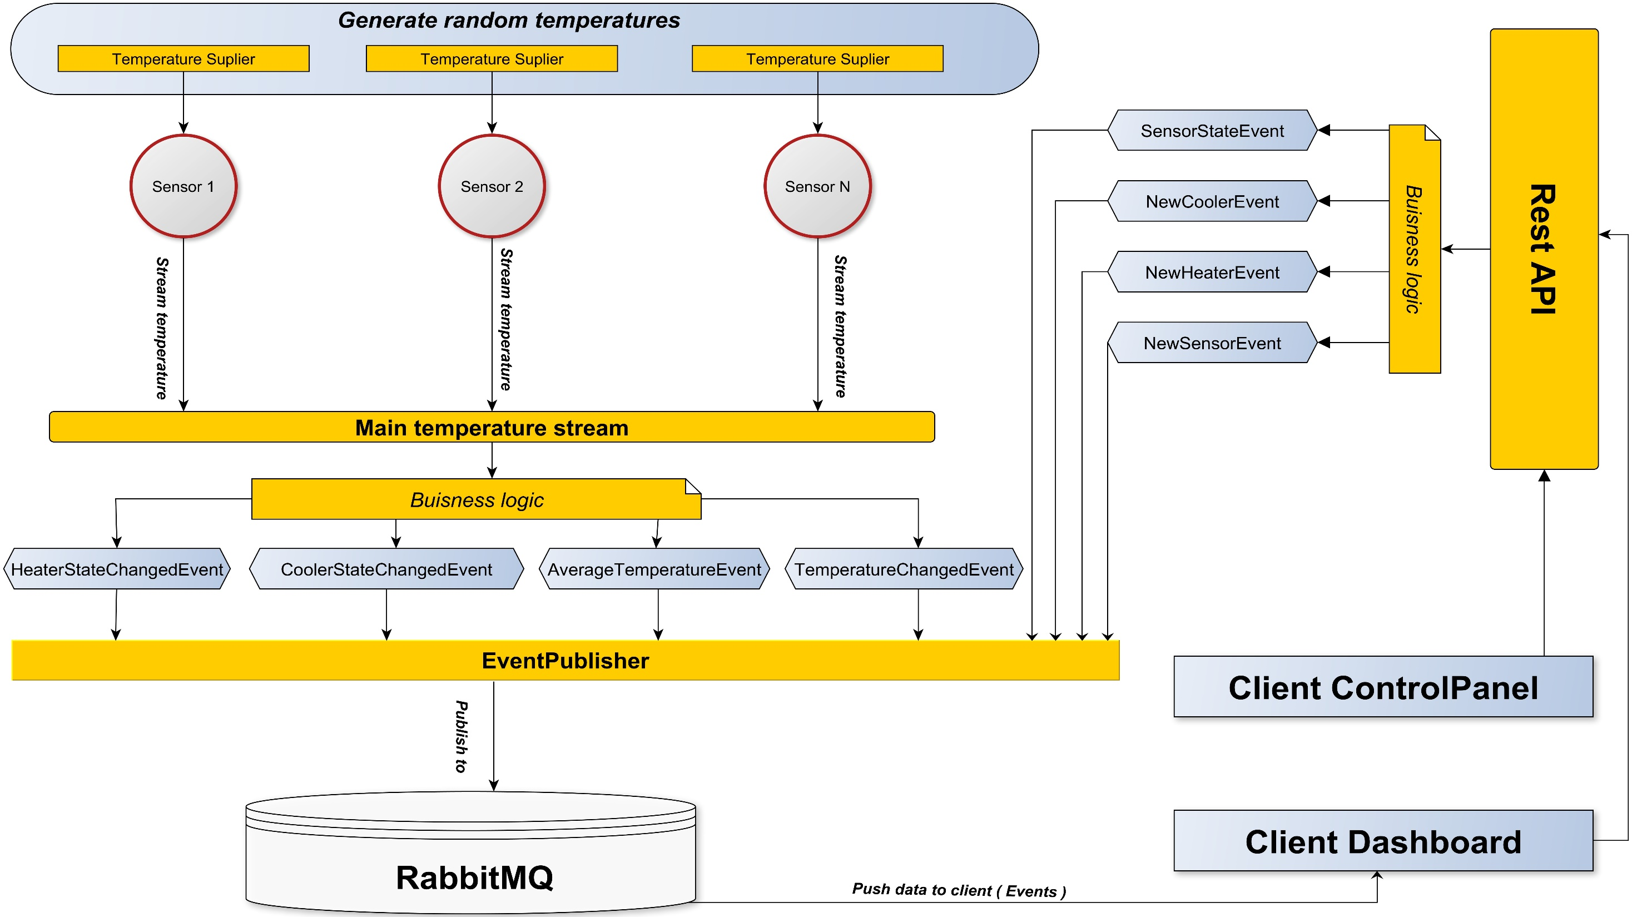

Slide 30

Any questions?

